Slide 1
Capstone Design Project: AA05 Automated Parking System
By: Taskin Abdur-Rahman, Zohraan Badar, Yadu Madhu, Kisoban Rajendran

Slide 2
02
03
04
01
PROBLEM DEFINITION
REQUIREMENTS
DESIGN & ANALYSIS
INTRODUCTION & OBJECTIVE
06
07
05
CHALLENGES
IMPLEMENTATION
PROJECT MANAGEMENT

Slide 3
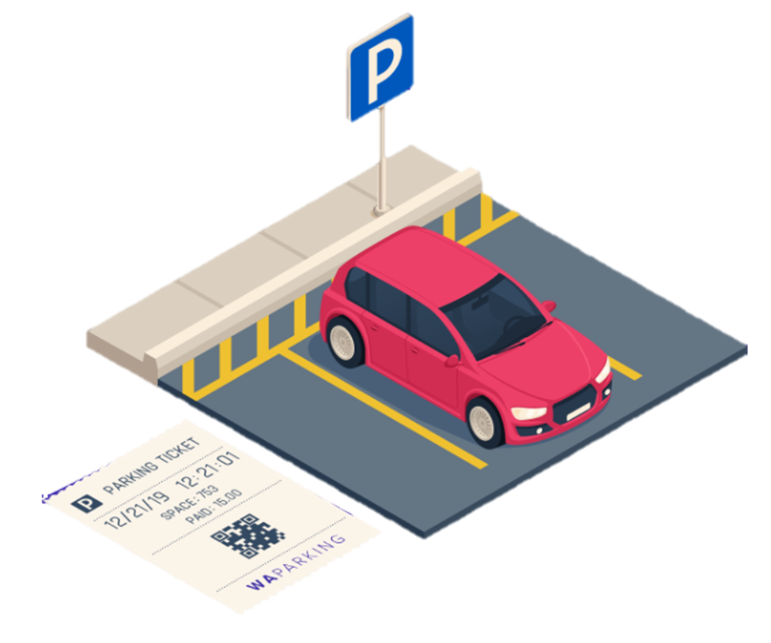
01
INTRODUCTION

Slide 4
INTRODUCTION
Parking lots today (ex. At a mall, airports, downtown) are very crowded and have unorganized traffic
Can be hard for people to find a parking spot
What we propose:
An Automated Vehicle Parking Management System.
Using image processing technology and IOT technology, it will be able to find the closest parking spot for our users
Objective: Demonstrate the effectiveness of an intelligent parking system using IoT technology.

Slide 5
Our design will…
Reduce parking lot traffic
Find the closest available parking spot for our customers
Implement a user-friendly interface to encourage users to continue to using it

Slide 6
02
Problem Definition

Slide 7
Problem Definition
Issues with the current parking situation :
Traditional parking systems lack efficiency in managing available parking spaces
Lack of real-time monitoring capabilities
Limited data collection for analyzing parking patterns and customer behaviors
Inefficient traffic flow within parking lots.
Reliance on manual monitoring and management.
Lack of user-friendly interfaces and guidance.
Objective: Develop an automated, user friendly, intelligent parking system using IoT technology to address the challenges of parking in crowded cities and airports
Notes:
Parking Challenges: The project addresses the issues of finding parking spaces efficiently in crowded areas
Real-time Monitoring: Aims to reduce delays in finding parking spots by implementing a system that monitors and provides real-time feedback on parking space availability.
Technological Integration: Utilizes IoT technology, wireless sensing, computer vision and reporting capabilities

Slide 8
03
Requirements

Slide 9
Customer Requirements
AA05 - Customer Requirements
Functional Requirements
AA05 - Functional Requirements

Slide 10
04
DESIGN & ANALYSIS

Slide 11
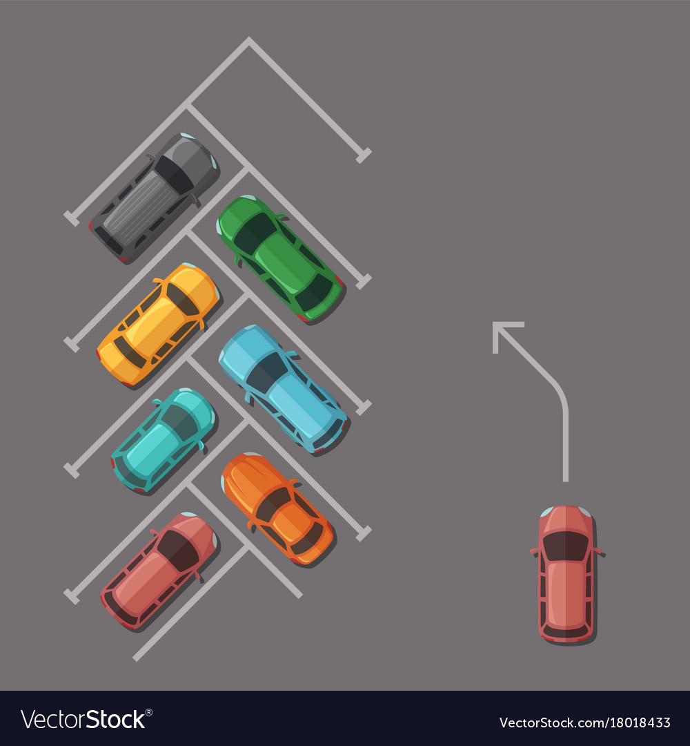
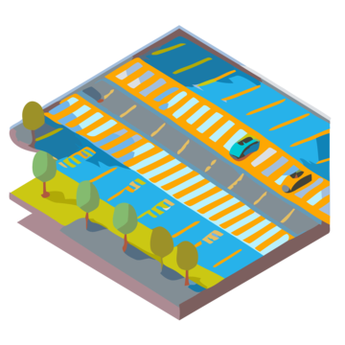
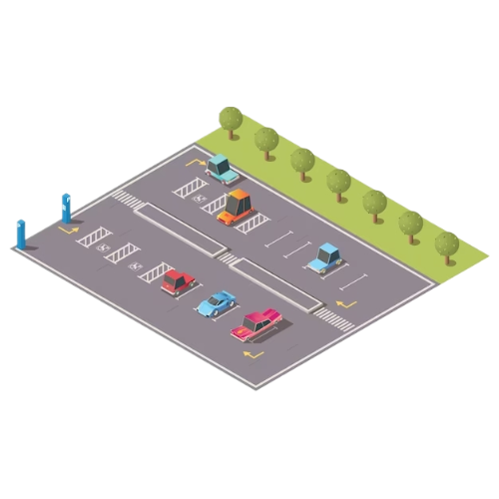
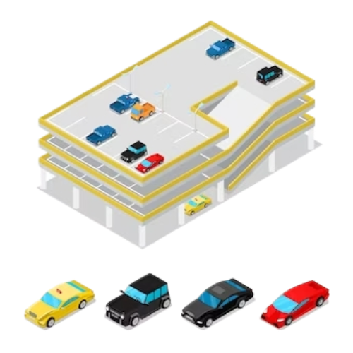
Some Analysis
Parking lots can vary in terms of
Space usage.
Parking space designs.
Routing and many more.
It also needs to account for various types of vehicles such as
Cars.
Trucks.
Vans
etc…

Slide 12
Analysis continued…
To account for such variations, a dynamic solution must be implemented, which can process situations with the least amount of constraints possible.

Slide 13

Camera

Slide 14
Design Choice
Cameras are versatile in its ability to solve multiple problems.
Camera’s can:
Detect multiple vehicles and parking spots.
Provide security surveillance.
Be self sufficient (Solar Power).
Be operated 24/7 regardless of weather conditions (With appropriate physical housing).
Due to these reasons, omitting the use of cameras for our solution results in suboptimal results.
We have decided to use the ESPCAM as it hits most of the points mentioned above.

Slide 15
System interconnectivity and more Design Choices
Cameras’ alone are not capable of managing a seamless parking experience.
Customers need a way to interact with the system in a user friendly manner.

Slide 16
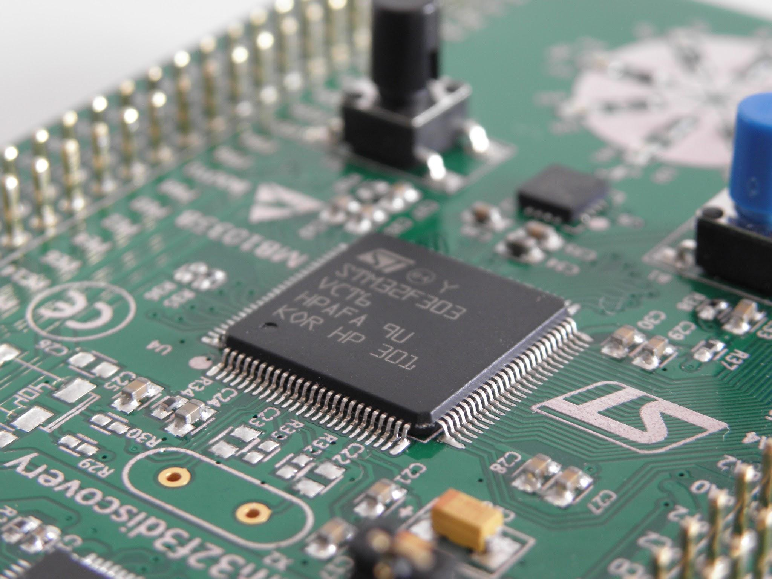
IOT Devices

Slide 17
System interconnectivity and more Design Choices
With the help of IOT devices, we can implement onsite hardware solutions that can link the customer to our on-site system.
There are many IOT devices that are valid candidates for our mission, however we picked the following based on the popularity and the documentation quality and quantity available.
ESP32, ESPCAM, LED lights and some weighing Sensors combined with the HX711 breakout board (Analog to Digital Converter for Weight Scales) are some of the devices that ticks the right boxes which we have chosen to integrate within our system.

Slide 18
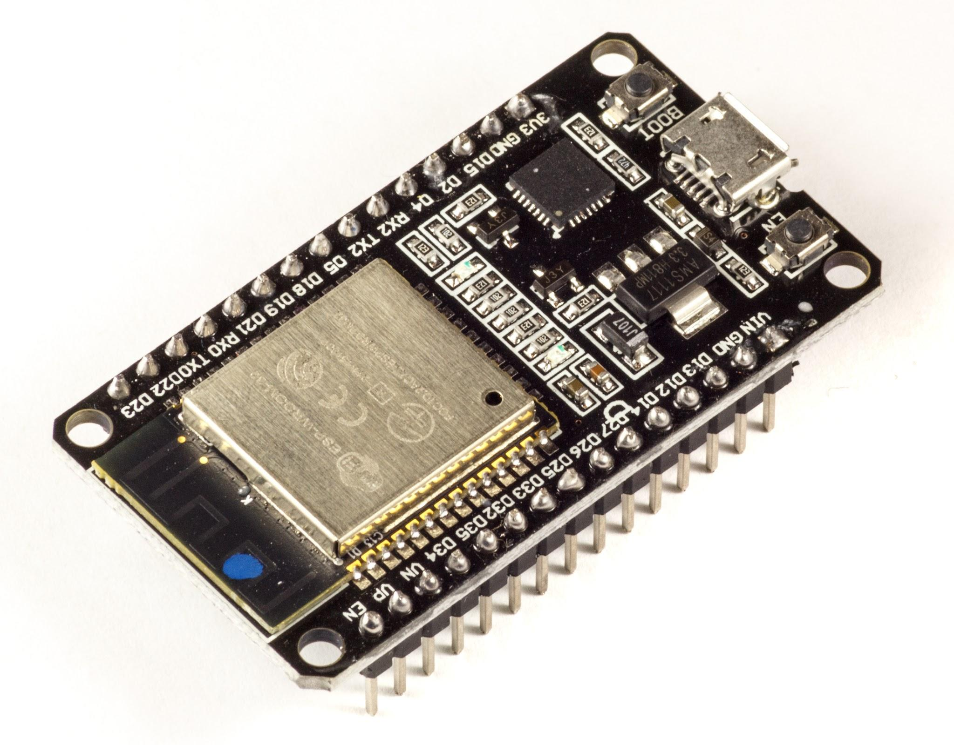
System interconnectivity and more Design Choices Continued…
Although IOT devices on-site help us bridge the gap between onsite functionality Users, it is critical that users can interact with the system externally. In today's age, with the prevalence of smartphones, taking advantage of the web is just as important. Hence a call to design and implement a mobile web application is necessary.

Slide 19

Web App Design

Slide 20

Design Choices
Other solutions such as mobile applications based on IOS/Android, or Windows/Linux based applications are not appropriate for this use case.
Rather the most appropriate in this scenario would a Web-Based application in the cloud, due to the following reasons:
Platform independent
Only requires access to internet
Access to private network not required
Improves usability as there is no need for installation and setup

Slide 21
05
CHALLENGES

Slide 22
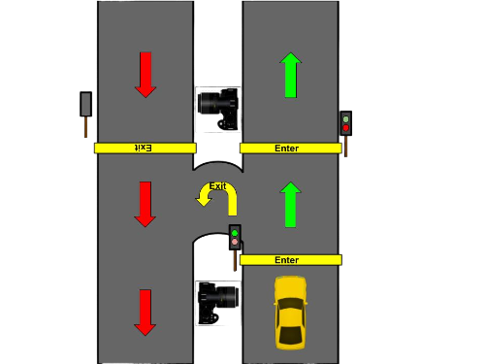
Challenge 1 & Solution: Solving Customer Entry and Exit
Entry and Exit Points are critical points in a parking lot. It is important to ensure a safe a seamless experience for the user. We have decided to incorporate a 2 gate system for the entry for user authentication. Here is the protocol that users must follow for the entrance.
- User will be stopped at the first gate so they can scan the QR code on their phone to the camera.
- If user fails the authorization attempts, they are redirected out of the system through the U-Turn exit.
- Otherwise, user may continue ahead.

Slide 23
Challenge 1: Continued…
The exit protocol is more simple where the user is stopped to acquire an exit QR code. The exit QR code serves as an updater/confirmation for when user leaves the parking lot.

Slide 24
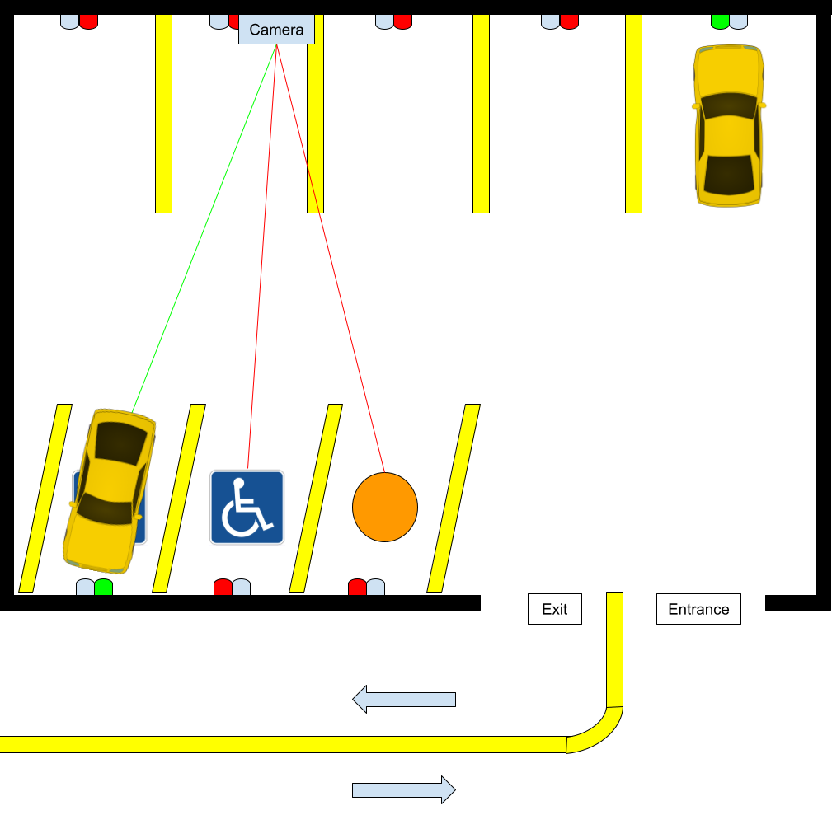
Challenge 2 & Solution: Designing a prototype parking lot model.
As discussed, before, parking lots have no similarities when it comes to dimensions, shape or other physical properties. We have instead decided to include every type of parking space to account for as many variables as we can. Some of the parking spaces include:
Accessible parking space.
Parallel parking space.
Angled parking space.

Slide 25
Challenge 2: Camera Placements for optimal coverage
It was discussed whether it was optimal for use computer vision and machine learning to monitor the occupancy of parking spots. The cons of this strategy involve the following.
Limits scalability as some parking lots limit visibility and limit available camera positions.
Increases the complexity of the project as it increase the number of cameras used.
Increases the setup overhead required to setup and calibrate the system as it depends on the reliability of the computer vision system.

Slide 26
06
Implementation Plan

Slide 27
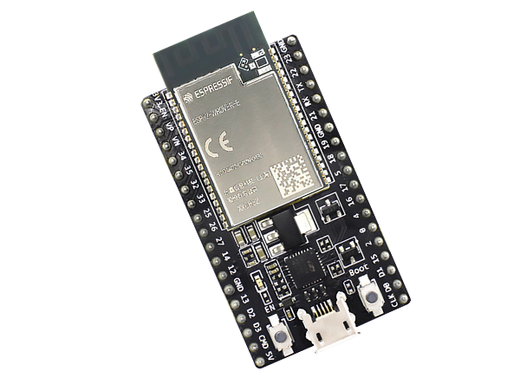



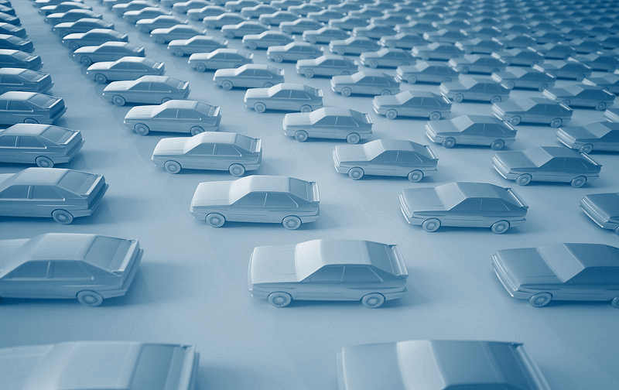
Parking Lot Interaction System
Frontend Web-App (React)
Integrates a hardware oriented solution to collect data and provide a seamless experience. Devices to be used include:
- ESP32.
- ESPCAM.
- Weight Sensors, LED lights.
Provides an important interface for the user to interact with the system. The application will be built using:
- REACT Vite
- Material UI (Styling)
Automated Parking Management Subsystems
We have broken down the primary functions of the system down to 4 CORE subsystems/components.
Backend Functions (GCLOUD)
Database Solution (Firebase)
Take advantage of cloud functions to execute important algorithms on the backend while connected to the database. We will use Cloud Functions to achieve this:
- GCloud Functions
Database solutions that offer remote code executions based on events is pretty important especially for live running systems with high uptime like ours. We have decided to pick:
- Firebase

Slide 28
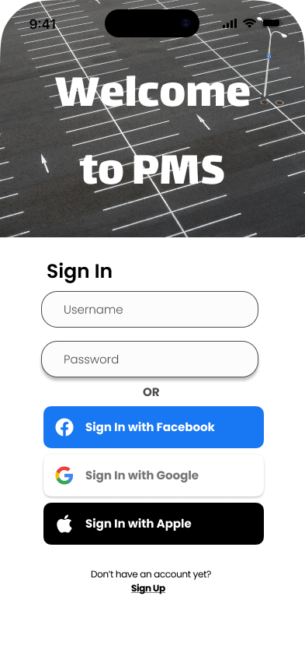
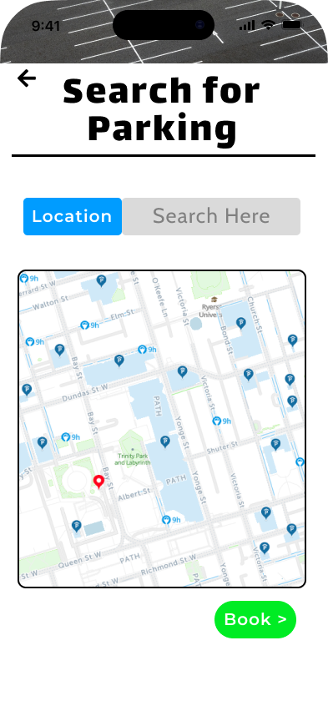
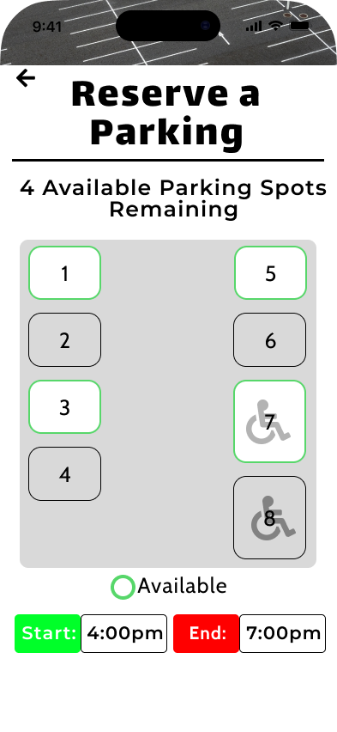
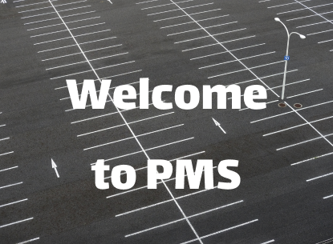
System User Interaction - React Web App
Step 1
Step 2
Step 3
Step 4
User visits web url
User authentication
Parking Lot Display
Reservation
User will be asked to scan the QR code displayed on the website
User will be asked to either sign up or sign in
User will receive an up to date top down view of the parking lot. User may pick one of the spots.
User will then be directed to a reservation page to make the reservation

Slide 29

Database Solution
Step 1
Step 2
Step 3
Step 4
Step 5
Step 6
Define Purpose and Goal
Gather Requirements
Create Schema
Entity-Rel Diagram
Implement and Test (Firebase)
Optimize, Deploy and Maintain
Main purpose/goal is to store information that can assist in building algorithms to automate parking management systems
Requirements:
- Store user Information.
- Store parking spot occupancy Information.
- Store Sensor Data Information.
- Store key parking lot related information.
Tables Created:
- USER
- BOOKING
- SENSOR_DATA
- PARKING_LOT
To be implemented.
To be implemented.
To be implemented.

Slide 30


Backend Cloud Functions for Firebase
01
Acquire quality data from websites such as Kaggle.
Think of different model architectures (CNN - convolutional neural network).
Integrate the model to be executed on the cloud.
ML Models for Vehicle Detection
02
Define the linear equation.
Identify the decision variables and add weights accordingly.
Set up physical constraints.
Linear optimization for building profit models
03
Acquire data from running sample simulations.
Research an appropriate filter model.
Integration strategies with Cloud functions.
ML Models for optimal parking spot suggestions
Notes:
Point 1 (Picked site to acquire good data, picked CNN due to familiarity)
We can get good image datasets from websites like kaggle for building the model.
I picked CNN as an example because that's what I am familiar with in the course I am currently taking which is Computer Vision
Think of how we can write and execute this function using Cloud functions
Point 2 (Still haven't came up with equations but, researched the general strategy)
Define a equation that identifies the cost in terms of time, and the occupancy rate of that parking spot.
Think of decision variables to add like, distance from that parking spot to facilities, general wait times, think of adding weights to each variable.
Think of physical constraints like how the cost of the ticket cannot exceed for example 20 dollars etc…
Point 3 (Similar to Point 1)
To acquire sample data for this, we can run scripts that randomly generates dummy data.
Research an appropriate filter model.
Think of how we can write and execute this function using Cloud functions

Slide 31
07
Project Management

Slide 32
Project Schedule
Step 1
Step 2
Step 3
Step 4
Step 5
Step 6
Technical Documents
Develop Vision System
Develop Web-App
Build Parking-Lot
Integration Testing
Optimize, Document and Present
Technical drawings, diagrams and schematics.
Parts ordered
Week 1 -2.
Develop and Functional test Vision system.
Week 3-7
Develop and Functional test Web-App.
Week 3-10
Build parking lot and perform functional testing.
Week 7-10
Integrate all components and test.
Week 10-12
Project completing and documentation, report, and demo.
Week 12-13

Slide 33
REFERENCES
[1] M. Gephardt, “Every drop counts: Can 20 seconds of hand-washing lead to water wasting?,” KSLTV.com, 01-Jul-2021. [Online]. Available: https://ksltv.com/465656/every-drop-counts-can-20-seconds-of-hand-washing-lead-to-water-wasting/ [Accessed: 22-Nov-2022].
[2] K. Wong, “Greywater Strategies,” Ground Water. https://www.groundwatercanada.com/greywater-strategies-1540/ (accessed November 22, 2022).
[3] “How does a sewage treatment plant work,” Premier Tech. https://www.premiertechaqua.com/en-gb/wastewater/how-does-a-sewage-treatment-plant-work#:~:text=Sewage%20treatment%20plants%20are%20an,contaminants%20and%20purify%20organic%20matter. (accessed November 22, 2022).
[4] Admin, “Everything you need to know about under sink water filters,” Water Filter Judge, 22-Jul-2021. [Online]. Available: https://waterfilterjudge.com/complete-guide-to-under-sink-water-filters/ . [Accessed: 20-Nov-2022].
[5] Greywater Reuse at Greywater action https://greywateraction.org/greywater-reuse/
(accessed November 21, 2022).
[6] The Water Wise Group https://waterwisegroup.com/greywater-education/greywater-benefits/
(accessed November 21, 2022).
[7] City of Toronto 2019 Water Rates & Fees https://www.toronto.ca/services-payments/property-taxes-utilities/utility-bill/water-rates-fees/2019-water-rates-and-fees/
[8] World Toilet Organization (WTO) https://www.worldtoilet.org/

Slide 34
REFERENCES CONTINUED
[9] Columbia Climate School, The Problem of Lawns
https://news.climate.columbia.edu/2010/06/04/the-problem-of-lawns/
[10] Admin, “Everything you need to know about under sink water filters,” Water Filter Judge, 22-Jul-2021. [Online]. Available: https://waterfilterjudge.com/complete-guide-to-under-sink-water-filters/ . [Accessed: 20-Nov-2022].
[11] “Biodigestor autolimpiable,” Rotoplas Argentina, 27-Aug-2021. [Online]. Available: https://rotoplas.com.ar/catalogo/biodigestor-autolimpiable/ . [Accessed: 22-Nov-2022].
[12] J. N. Meegoda, B. Li, K. Patel, and L. B. Wang, “A review of the processes, parameters, and optimization of anaerobic digestion,” International journal of environmental research and public health, 11-Oct-2018. [Online]. Available: https://www.ncbi.nlm.nih.gov/pmc/articles/PMC6210450/ . [Accessed: 22-Nov-2022].
[13] Aurelien. (2022, September 30). How much water does a toilet use? - plumbing paramedics. Plumbing and Heating Paramedics. Retrieved November 22, 2022, from https://plumbingparamedics.ca/how-much-water-does-a-toilet-use/#:~:text=They%20ideally%20allow%20for%20a,(1.1%20gallons)%20per%20flush
[14] “Hydraulic Pumps & Motors | Power & Motion.” [Online]. Available: https://www.powermotiontech.com/hydraulics/hydraulic-pumps-motors . [Accessed: 22-Nov-2022].
|
[15] “Increasing your facility's water efficiency,” Hospital News, 26-Aug-2015. [Online]. Available: https://hospitalnews.com/increasing-facilitys-water-efficiency/#:~:text=As%20a%20result%2C%20health%20care,liters%20per%20bed%20per%20day . [Accessed: 22-Nov-2022].
[16] Sepro, “Peristaltic pumps are versatile and eco-friendly,” Sepro Mixing, 08-Feb-2022. [Online]. Available: https://mixing.seprosystems.com/peristaltic-pumps-are-versatile-and-eco-friendly/#:~:text=This%20type%20of%20pump%20has,that%20draws%20in%20fresh%20slurry.[Accessed: 22-Nov-2022].

